Slide 1

Towards Weakly- and Semi- Supervised Object Localization and Semantic Segmentation
Lecturer: Yunchao Wei
Image Formation and Processing (IFP) Group
University of Illinois at Urbana-Champaign
https://weiyc.github.io

Slide 2
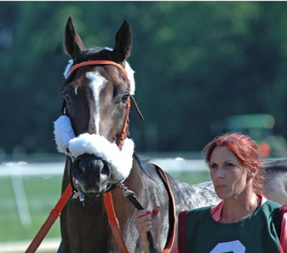




Fully Supervised Semantic Segmentation
Hard to Collect
Fully Convolutional Networks
…
…
Masks
…
…

Slide 3

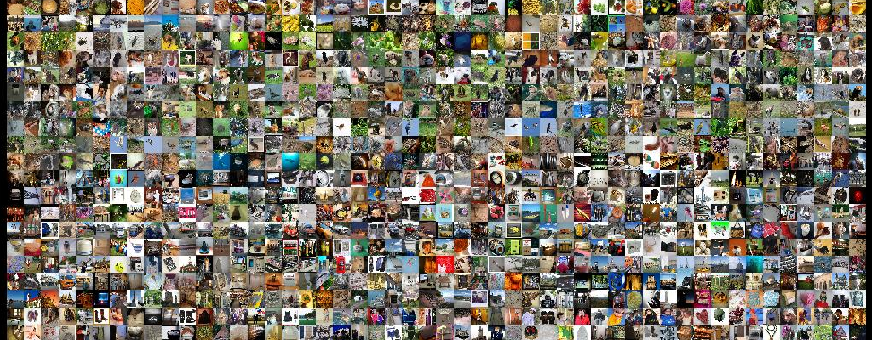

Slide 4
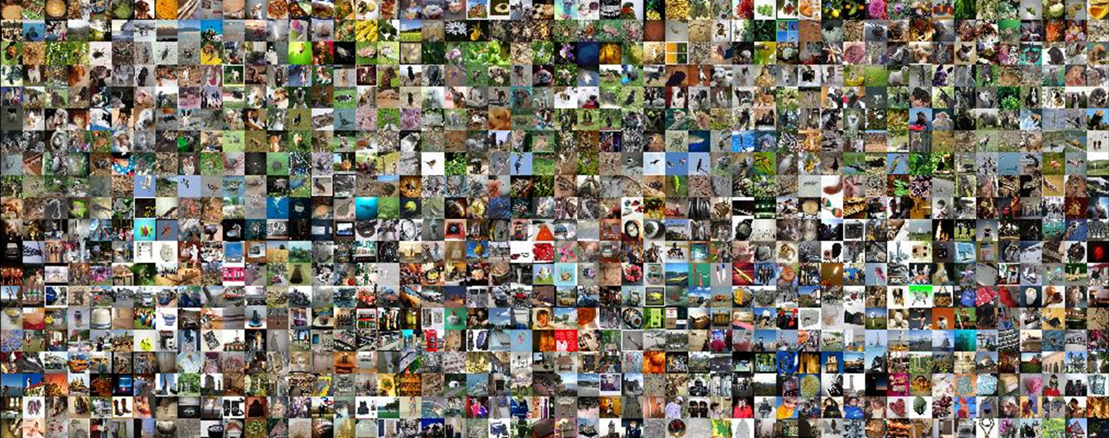


20K+
Categories
100/C
2M+
Instances
5min/I
19 years
/ person

Slide 5
Weakly Supervised Annotations
bounding boxes
scribbles
points
image-level labels
horse
horse person
person
The simplest and the most efficient one

Slide 6
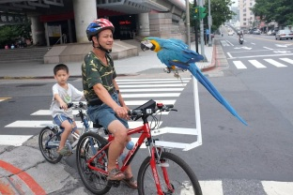
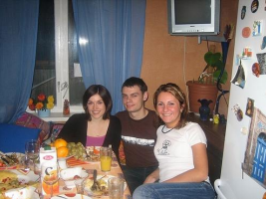
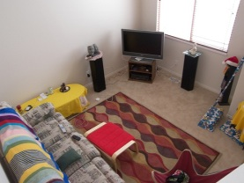
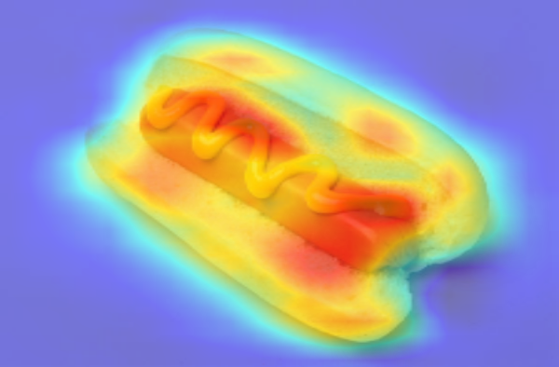
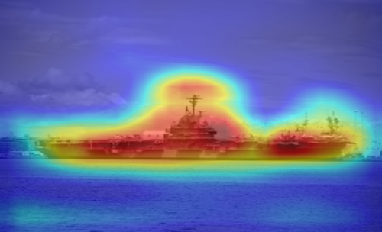
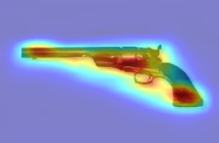
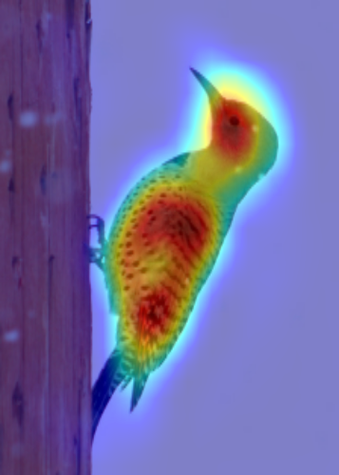
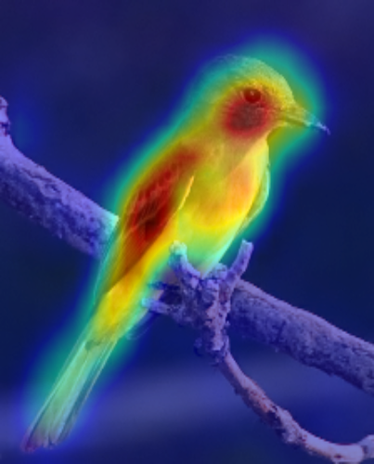
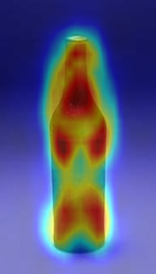
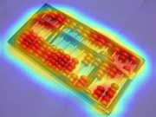
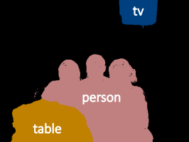
Our Targets
images
Object Localization Maps
Loc
…
annotations
Seg
person
horse
…
table
Notes:
Here, I give a brief introduction of our concerned weakly-setting.
We leverage image-level label as supervision and learn models for conducting object localization and segmentation.
In such settings, the main challenge is how to build relationship between image-level labels and pixels.
The following works are exactly to address such an issue by inferring high-quality object localization maps.

Slide 7
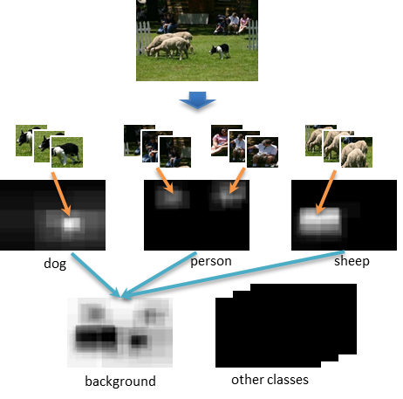
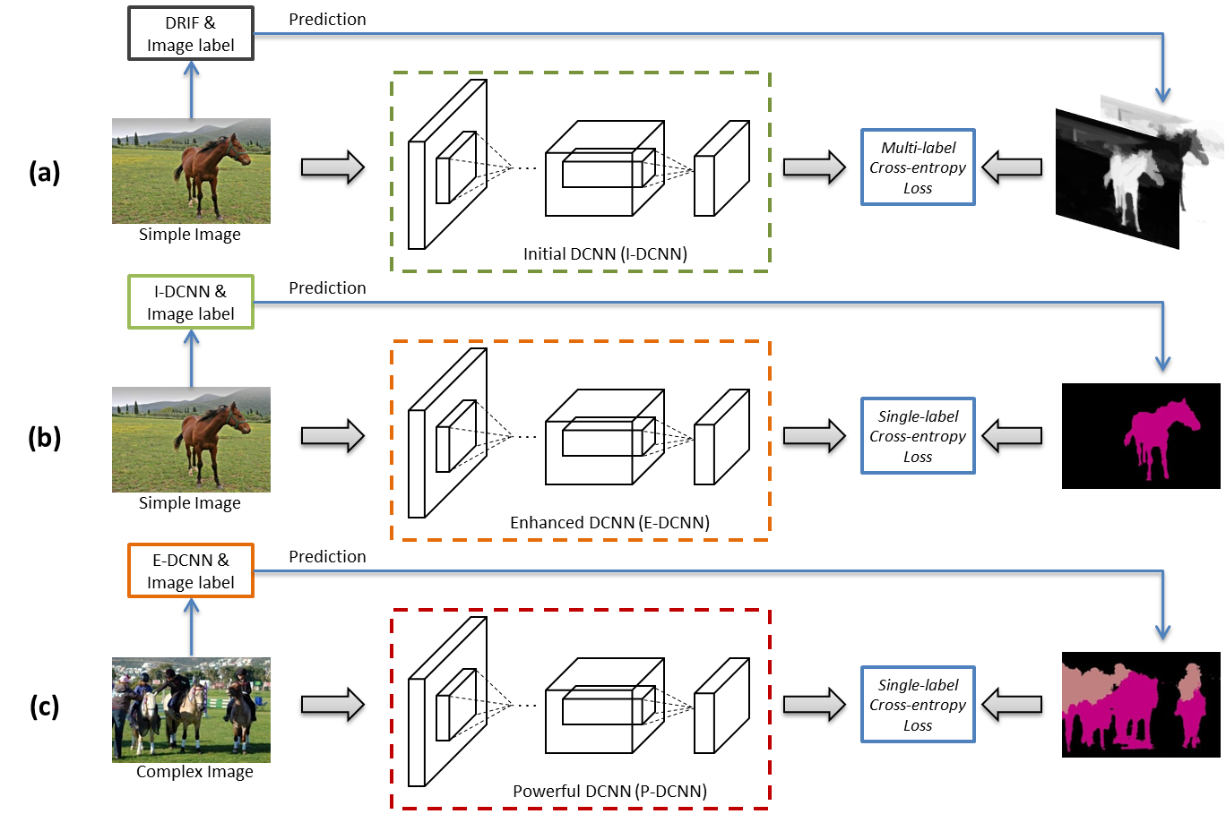
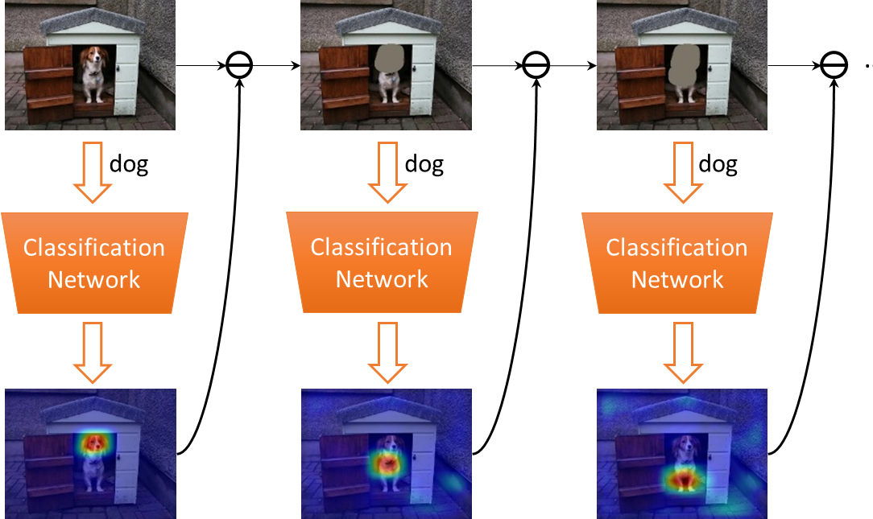
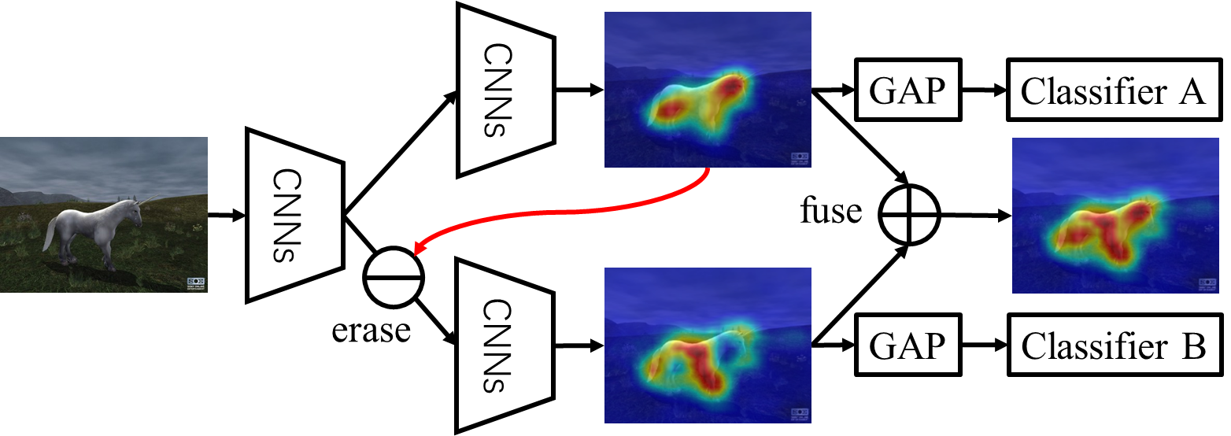
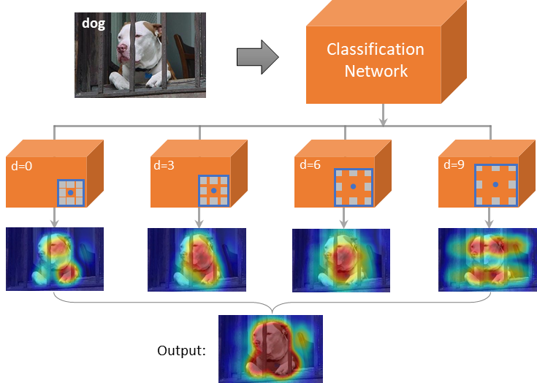
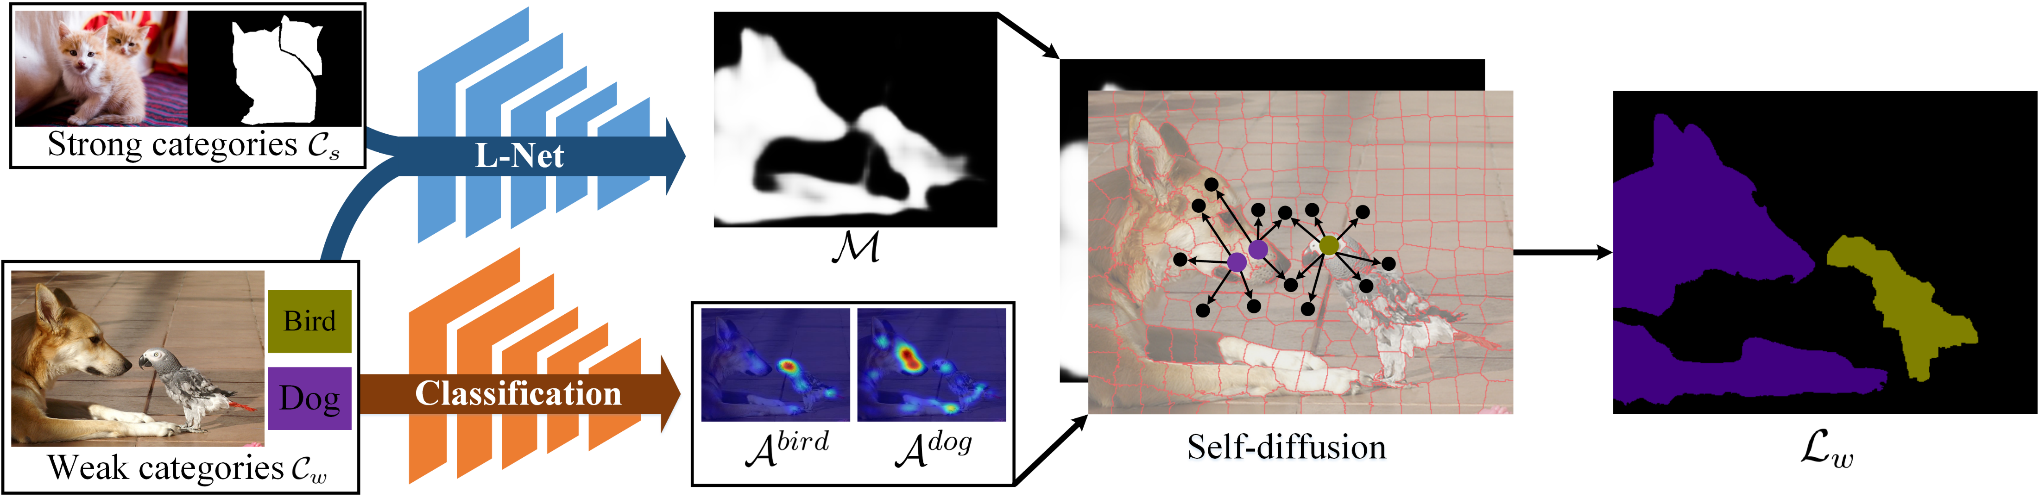
Achievements
PR 2016
PAMI 2017
CVPR 2017
Proposal-based Localization
Simple to Complex
Adversarial Erasing
CVPR 2018
CVPR 2018
AAAI 2018
Adversarial Complementary Learning
Multi-dilated Convolution
Transferable Semi-supervised Network

Slide 8
Achievements
PR 2016
PAMI 2017
CVPR 2017
Proposal-based Localization
Simple to Complex
Adversarial Erasing
CVPR 2018
CVPR 2018
AAAI 2018
Adversarial Complementary Learning
Multi-dilated Convolution
Transferable Semi-supervised Network

Slide 9
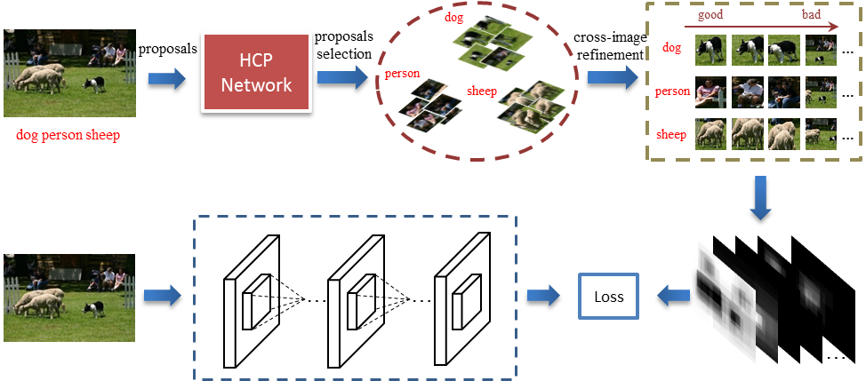
Proposal-based Localization
Learning to Segment with Image-level Annotations. PR 2016

Slide 10
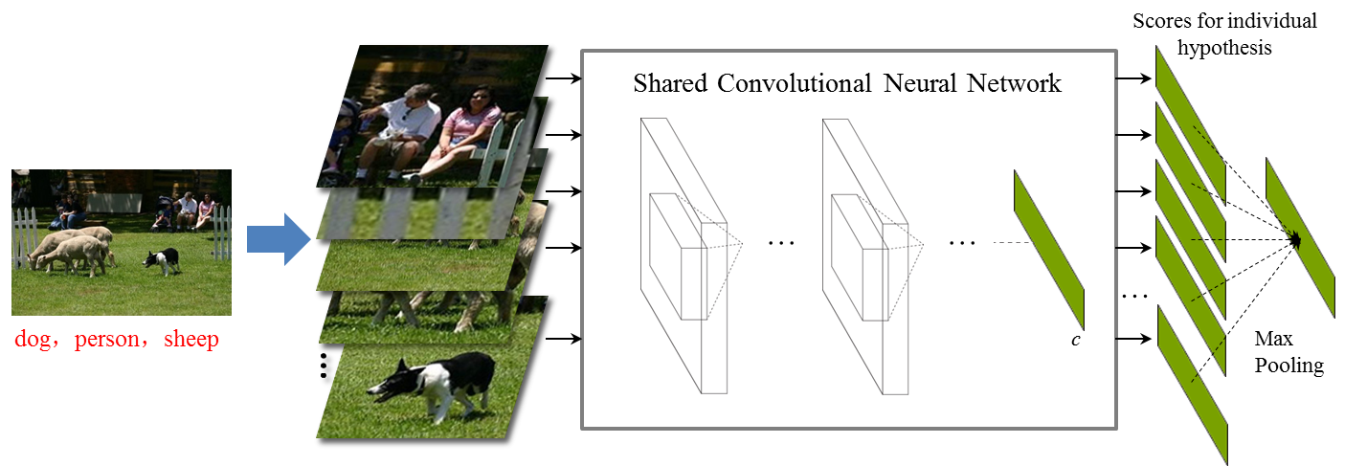
Proposal-based Localization
Pascal VOC
43.2%
Hypotheses-CNN-Pooling
Localization Map Generation
Weakness
Exhaustedly examine each proposal to generate localization
Introducing false negative pixels(background)
Learning to Segment with Image-level Annotations. PR 2016

Slide 11
Achievements
PR 2016
PAMI 2017
CVPR 2017
Proposal-based Localization
Simple to Complex
Adversarial Erasing
CVPR 2018
CVPR 2018
AAAI 2018
Adversarial Complementary Learning
Multi-dilated Convolution
Transferable Semi-supervised Network

Slide 12
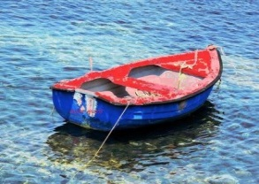
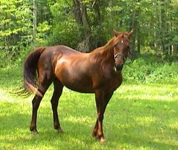


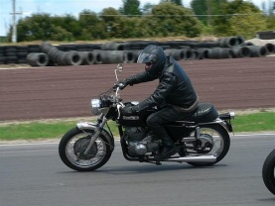

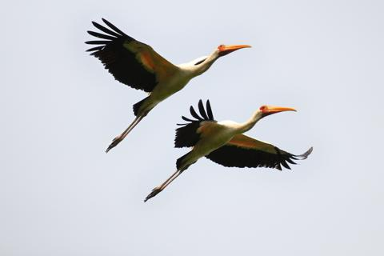

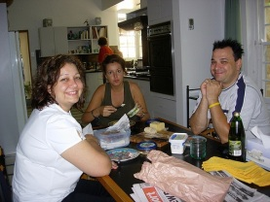
Simple to Complex
Simple Images
Complex Images
STC: A Simple to Complex Framework for Weakly-supervised Semantic Segmentation. PAMI 2017

Slide 13
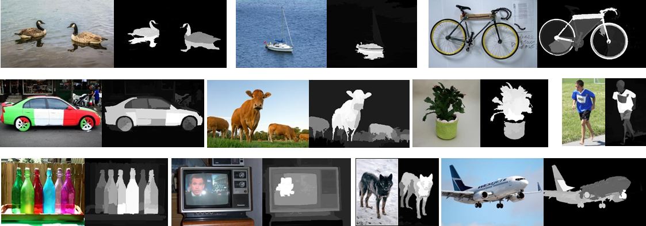
Simple to Complex
Simple images with the corresponding saliency maps
STC: A Simple to Complex Framework for Weakly-supervised Semantic Segmentation. PAMI 2017

Slide 14
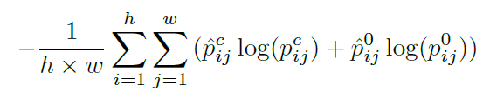
Simple to Complex
Initial-DCNN
Enhanced-DCNN
Powerful-DCNN
STC: A Simple to Complex Framework for Weakly-supervised Semantic Segmentation. PAMI 2017

Slide 15
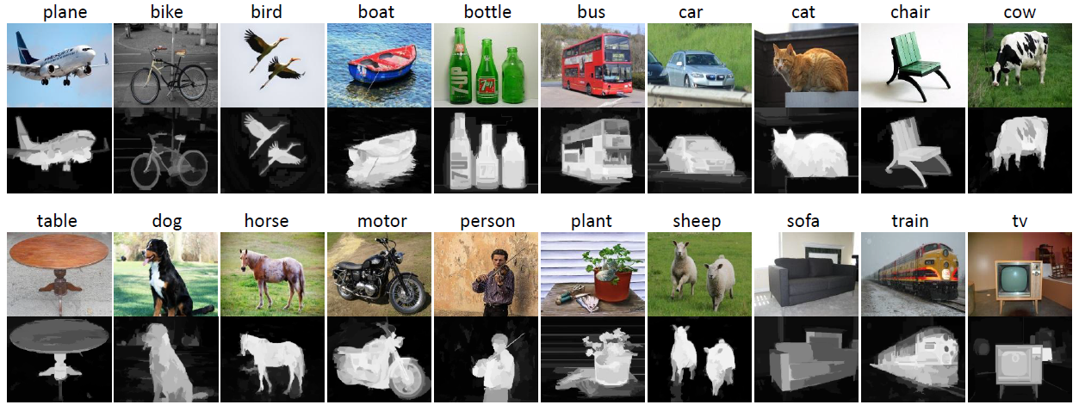
Simple to Complex
Flickr-Clean (40K)
STC: A Simple to Complex Framework for Weakly-supervised Semantic Segmentation. PAMI 2017

Slide 16
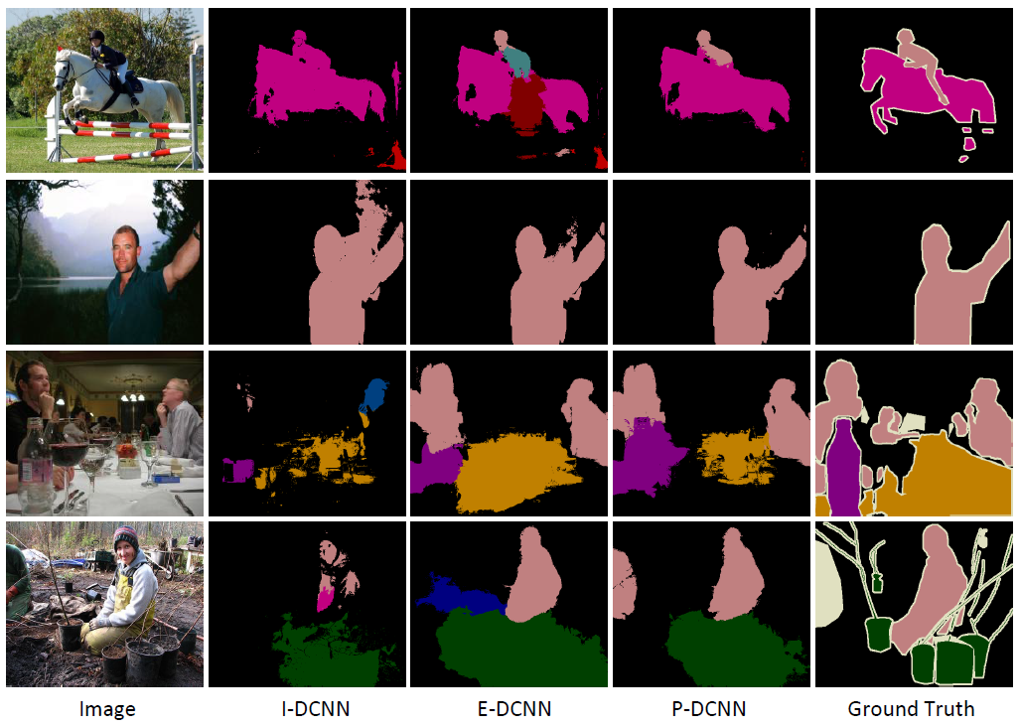
Simple to Complex
Pascal VOC
43.2%
51.2%
Ablation Analysis on Pascal VOC12 val
Networks | Training Set | mIoU
I-DCNN | Flickr-Clean | 44.1
E-DCNN | Flickr-Clean | 46.8
P-DCNN | Flickr-Clean+VOC | 49.8
Weakness
Collecting a large number of simple images
Time consuming for training
STC: A Simple to Complex Framework for Weakly-supervised Semantic Segmentation. PAMI 2017

Slide 17
Achievements
PR 2016
PAMI 2017
CVPR 2017
Proposal-based Localization
Simple to Complex
Adversarial Erasing
CVPR 2018
CVPR 2018
AAAI 2018
Adversarial Complementary Learning
Multi-dilated Convolution
Transferable Semi-supervised Network

Slide 18
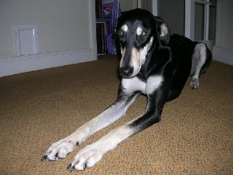
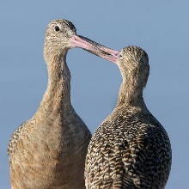
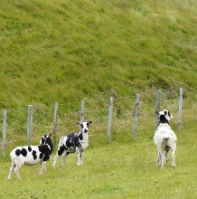
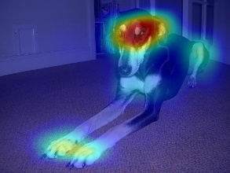
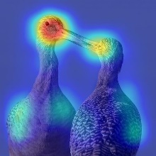
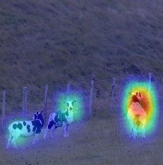
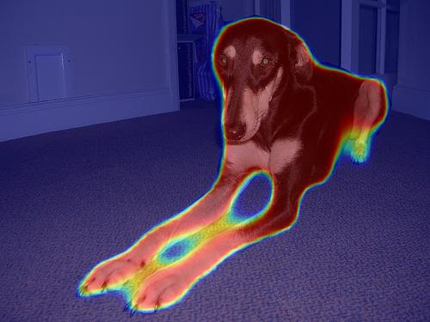
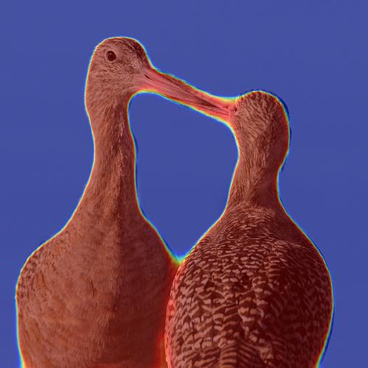
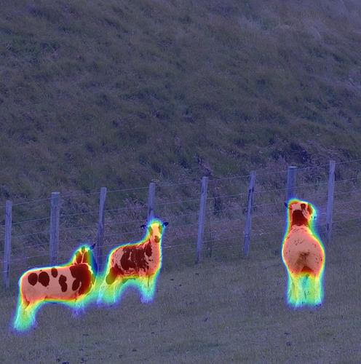
Adversarial Erasing
dog
bird
cow
Previous works
Our target
Small and sparse object localization maps
Dense and integral object localization maps
Object Region Mining with Adversarial Erasing: A Simple Classification to Semantic Segmentation Approach. CVPR 2017 (oral)

Slide 19



Adversarial Erasing
Motivation
conf: 1.0
conf: 0.8
conf: 0.5
head
body
foot
Object Region Mining with Adversarial Erasing: A Simple Classification to Semantic Segmentation Approach. CVPR 2017 (oral)

Slide 20
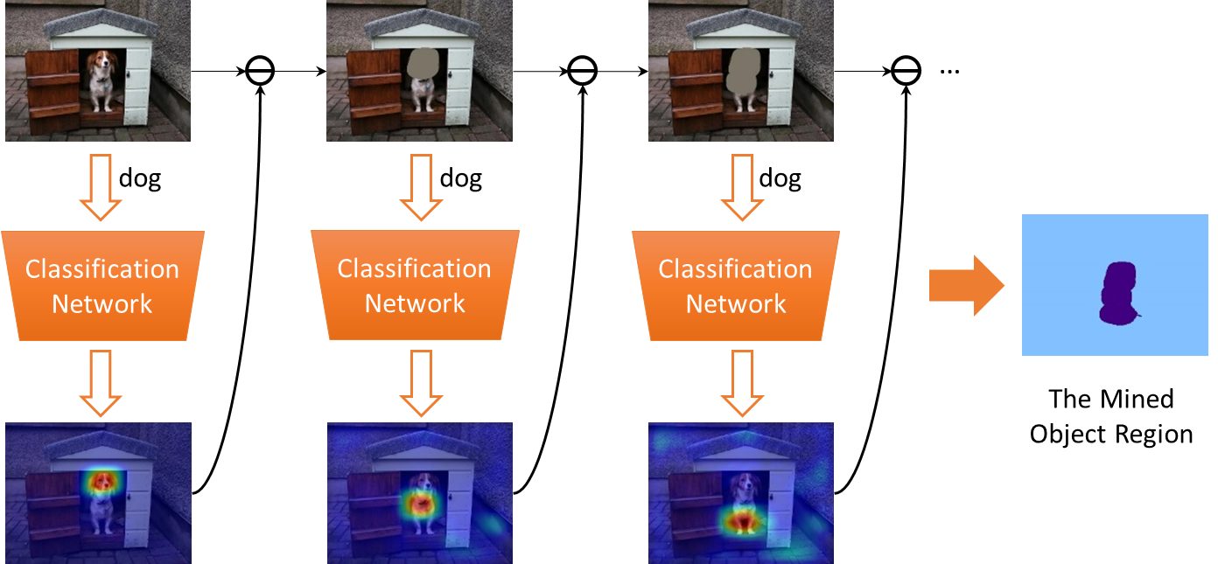
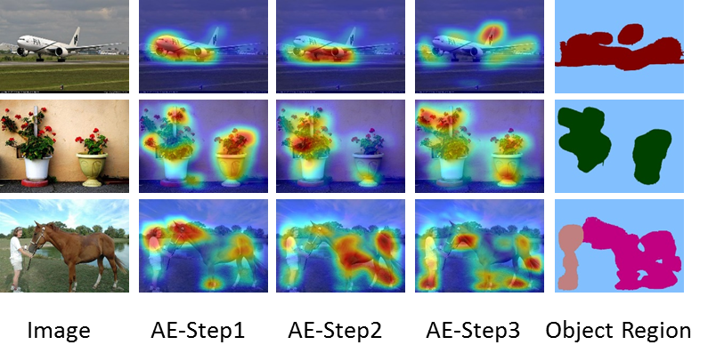
Adversarial Erasing
Our Solution
Visualizations
Object Region Mining with Adversarial Erasing: A Simple Classification to Semantic Segmentation Approach. CVPR 2017 (oral)

Slide 21
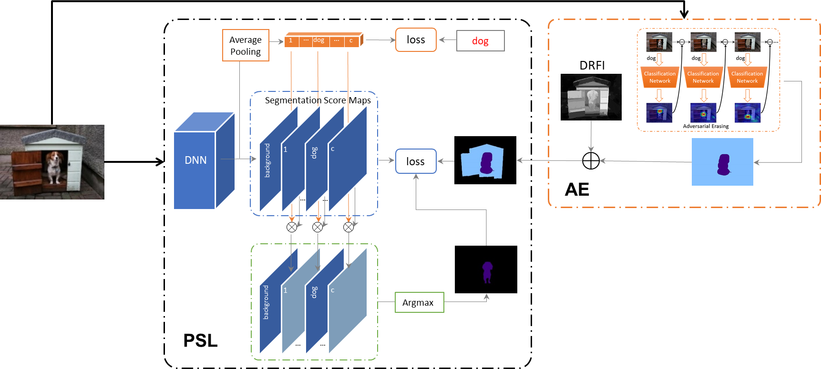
Adversarial Erasing
The pipeline of weakly semantic segmentation based on AE
Object Region Mining with Adversarial Erasing: A Simple Classification to Semantic Segmentation Approach. CVPR 2017 (oral)

Slide 22
Weakness of Adversarial Erasing
Pascal VOC
43.2%
51.2%
Time consuming to learn several classification networks.
Hard to determine how many AE steps should be conducted.
55.7%
Object Region Mining with Adversarial Erasing: A Simple Classification to Semantic Segmentation Approach. CVPR 2017 (oral)
Notes:
It is not elegant and time consuming to learn…
Although, this work provide a solution by observing loss curves of classification networks, in fact, it is not a good one.
Seeking elegant solutions

Slide 23
Achievements
PR 2016
PAMI 2017
CVPR 2017
Proposal-based Localization
Simple to Complex
Adversarial Erasing
CVPR 2018
CVPR 2018
AAAI 2018
Adversarial Complementary Learning
Multi-dilated Convolution
Transferable Semi-supervised Network

Slide 24
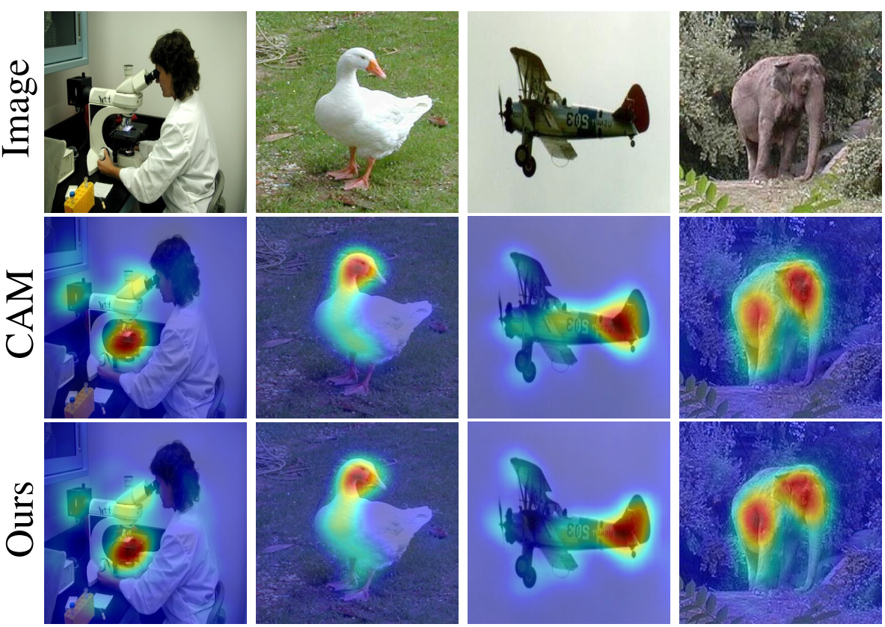
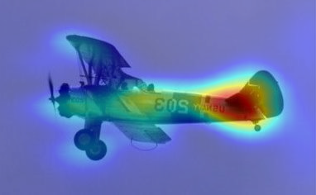
Adversarial Complementary Learning
Revisiting CAM
Classification
Images
CAM
GAP
FC
…
CAM
Ours
Conv 1x1
GAP
…
Ours
Adversarial Complementary Learning for Weakly Supervised Object Localization. CVPR 2018

Slide 25
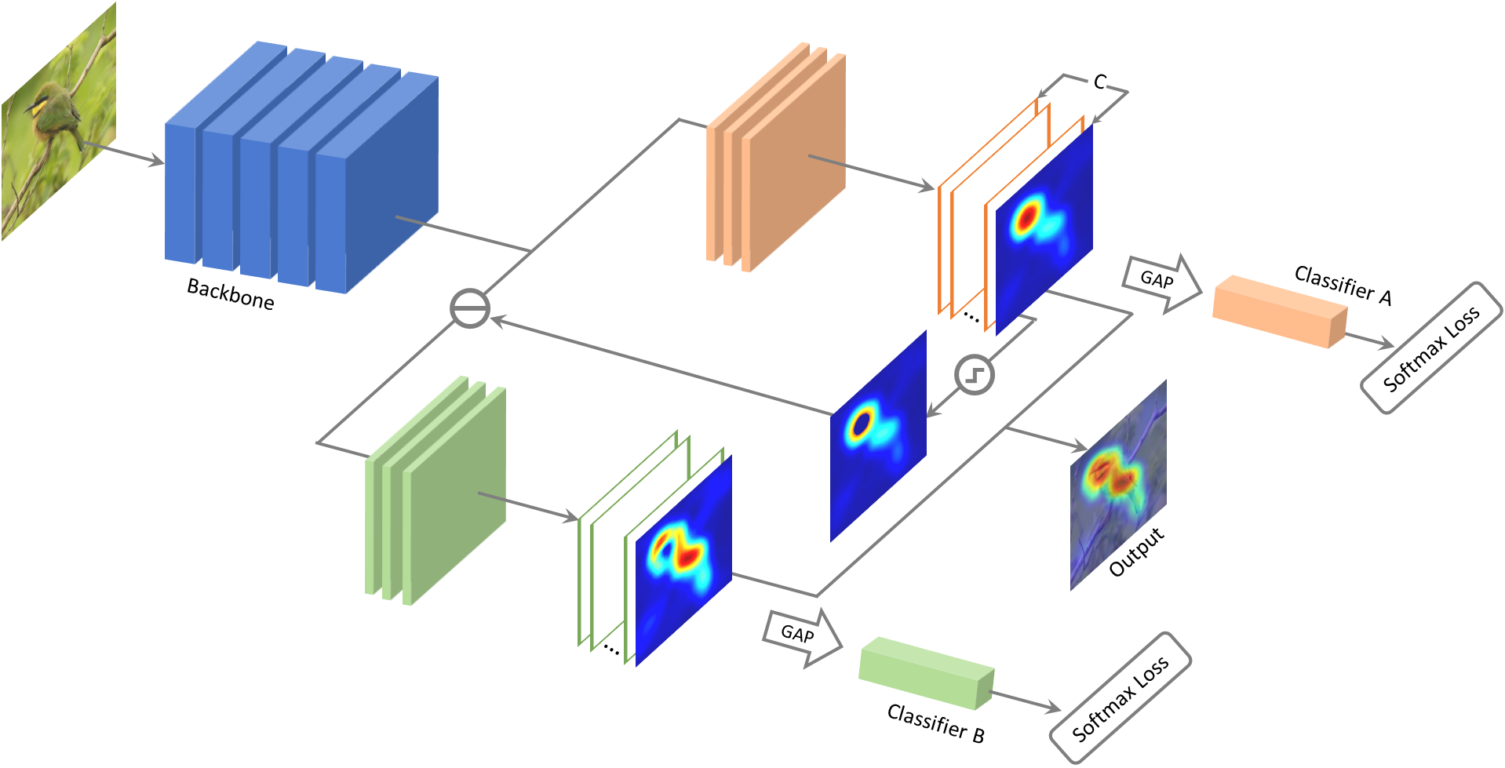
Adversarial Complementary Learning
Detailed Framework
Erasing
Thresholding
Adversarial Complementary Learning for Weakly Supervised Object Localization. CVPR 2018

Slide 26
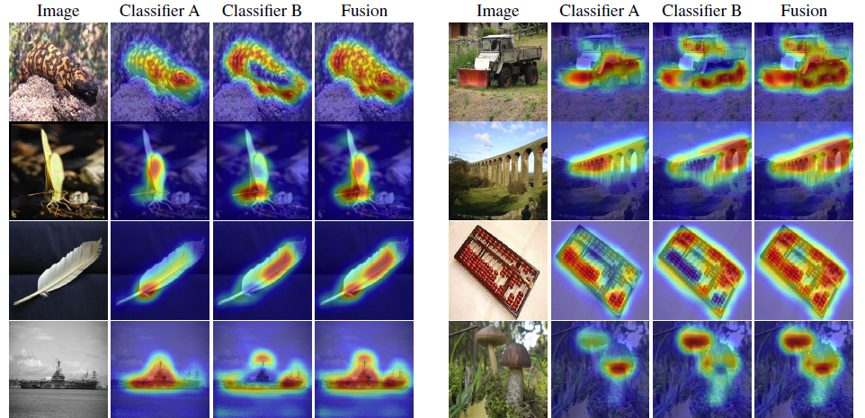
Adversarial Complementary Learning
Adversarial Complementary Learning for Weakly Supervised Object Localization. CVPR 2018

Slide 27
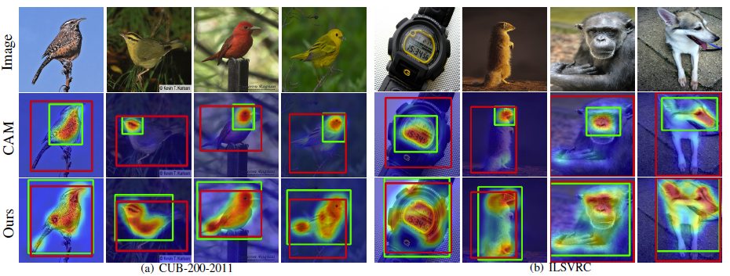
Adversarial Complementary Learning
Localization Comparison
Adversarial Complementary Learning for Weakly Supervised Object Localization. CVPR 2018

Slide 28
Adversarial Complementary Learning
Pascal VOC
43.2%
51.2%
Localization error on ILSVRC validation set
55.7%
Methods | Top-1 err. | Top-5 err.
Backprop on GoogleLeNet | 61.31 | 50.55
GoogLeNet-GAP (CVPR 2016) | 56.40 | 43.00
GoogLeNet-HaS-32 (ICCV 2017) | 54.53 | -
GoogLeNet-ACoL(Ours) | 53.28 | 42.58
GoogLeNet-ACoL*(Ours) | 53.28 | 35.22
Backprop on VGGnet | 61.12 | 51.46
VGG-GAP (CVPR 2016) | 57.20 | 45.14
VGGnet-ACoL(Ours) | 54.17 | 40.57
VGGnet-ACoL*(Ours) | 54.17 | 36.66
58.8%
Adversarial Complementary Learning for Weakly Supervised Object Localization. CVPR 2018

Slide 29
Achievements
PR 2016
PAMI 2017
CVPR 2017
Proposal-based Localization
Simple to Complex
Adversarial Erasing
CVPR 2018
CVPR 2018
AAAI 2018
Adversarial Complementary Learning
Multi-dilated Convolution
Transferable Semi-supervised Network

Slide 30
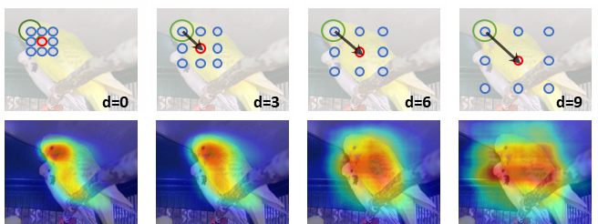
Multi-dilated Convolution
Motivation
In
kernel
3x3
Out
Revisiting Dilated Convolution: A Simple Approach for Weakly- and Semi-Supervised Semantic Segmentation. CVPR 2018 (spotlight)
Notes:
Based an interesting observation, we propose a novel and extreme simple approach to generate high quality object localization maps in this paper.

Slide 31
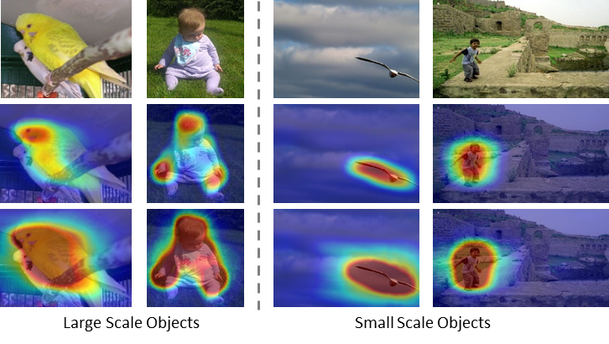
Multi-dilated Convolution
Multi-dilated Convolutional Network for Object Localization
Revisiting Dilated Convolution: A Simple Approach for Weakly- and Semi-Supervised Semantic Segmentation. CVPR 2018 (spotlight)
Notes:
Robust to small and large

Slide 32

Multi-dilated Convolution
Revisiting Dilated Convolution: A Simple Approach for Weakly- and Semi-Supervised Semantic Segmentation. CVPR 2018 (spotlight)

Slide 33

Multi-dilated Convolution
Weakly- and Semi- Supervised Semantic Segmentation
Revisiting Dilated Convolution: A Simple Approach for Weakly- and Semi-Supervised Semantic Segmentation. CVPR 2018 (spotlight)

Slide 34

Multi-dilated Convolution
Pascal VOC
43.2%
51.2%
55.7%
58.8%
60.8%
68.5%
Revisiting Dilated Convolution: A Simple Approach for Weakly- and Semi-Supervised Semantic Segmentation. CVPR 2018 (spotlight)

Slide 35
Achievements
PR 2016
PAMI 2017
CVPR 2017
Proposal-based Localization
Simple to Complex
Adversarial Erasing
CVPR 2018
CVPR 2018
AAAI 2018
Adversarial Complementary Learning
Multi-dilated Convolution
Transferable Semi-supervised Network

Slide 36

Transferable Semi-supervised Network
In-category Semi-supervised Semantic Segmentation (I3S)
Transferable Semi-supervised Semantic Segmentation. AAAI 2018

Slide 37
20K+
Categories
100/C
2M+
Instances
5min/I
19 years
/ person

Slide 38

Transferable Semi-supervised Network
In-category Semi-supervised Semantic Segmentation (I3S)
Cross-category Semi-supervised Semantic Segmentation (C3S)
Transferable Semi-supervised Semantic Segmentation. AAAI 2018

Slide 39

Transferable Semi-supervised Network
Label Transfer Network
(L-Net)
Prediction Transfer Network
(P-Net)
Transferable Semi-supervised Semantic Segmentation. AAAI 2018

Slide 40



Transferable Semi-supervised Network
denotes the standard element-wise binary cross-entropy loss
Transferable Semi-supervised Semantic Segmentation. AAAI 2018

Slide 41

Transferable Semi-supervised Network
Classification Activation Map
Transferable Semi-supervised Semantic Segmentation. AAAI 2018

Slide 42

Transferable Semi-supervised Network
Random Walk based self-diffusion algorithm
Transferable Semi-supervised Semantic Segmentation. AAAI 2018

Slide 43

Transferable Semi-supervised Network
Transferable Semi-supervised Semantic Segmentation. AAAI 2018

Slide 44

Transferable Semi-supervised Network
Transferable Semi-supervised Semantic Segmentation. AAAI 2018

Slide 45

Transferable Semi-supervised Network
Pascal VOC
43.2%
51.2%
55.7%
58.8%
60.8%
68.5%
64.6%

Slide 46

Transferable Semi-supervised Semantic Segmentation. AAAI 2018

Slide 47
Summary
PR 2016
PAMI 2017
CVPR 2017
images
Object Localization Maps
Loc
…
Proposal-based Localization
Simple to Complex
Adversarial Erasing
CVPR 2018
CVPR 2018
AAAI 2018
annotations
Seg
person
horse
…
table
Adversarial Complementary Learning
Multi-dilated Convolution
Transferable Semi-supervised Network

Slide 48

Thanks

